Slide 1
The Happiness Project
UWA Data Analytics Bootcamp
Dale Currigan, Jimmy Faccioli, Adam Lever

Slide 2
What makes us happy? How do happiness levels across the world differ and what influences a nation's state of happiness?
The 2021 World Happiness Report investigates these questions while reviewing the state of happiness across the world.
The report is increasingly being used by governments, organisations and civil society to inform policy-making decisions and to assess the progress of nations.
We set out to investigate and analyse these questions as the innate desire for happiness is in all of us.
1. Motivation and Summary

Slide 3
So what Makes us Happy?
Who is Happy?
How has the Covid-19 pandemic affected happiness?
How happy are we in Australia?
We found that the wealth of a nation plays a role in its happiness levels, however money is only part of the story. Social Support and Freedom both play key roles. We also found that people with higher levels of happiness have a longer life expectancy.
Western countries tended to be happier, with the Northern Hemisphere of the world happier than the Southern Hemisphere. Australia ranked 11th in the ratings, with Finland ranked first and Afghanistan last.
2. Questions

Slide 4
Open source data was retrieved in the form of .csv files and an API was used to request Covid-19 data.
To answer these questions data from 149 countries was analysed. A Happiness Score for each country was sourced from the 2021 World Happiness Report and used to rank and compare countries as well as to investigate correlating factors.
Additional Data sourced from the 2021 World Happiness Report included;
GDP Per Capita
Social Support
Life Expectancy
Freedom
Generosity
Corruption
Further GDP per capita data, as well as climate data, was also sourced from the World Bank
Mental Health Data was sourced from the World Health Organisation
Covid-19 data was sourced from https://about-corona.net/ which utilises data from the World Health Organisation, Johns Hopkins CSSE and various governmental sources.
3. Data Cleanup and Exploration

Slide 5
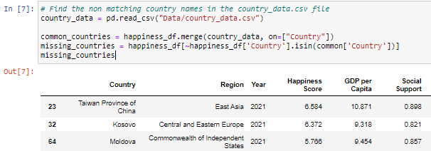
Process;
149 countries in the Happiness 2021 dataset needed matching with 10 other individual data files and sources
Country names compared, renamed and then merged with the primary datasource (‘happiness_df’)
Merging was easier on 2 or 3 letter country codes than country name
Nan and blanks kept in the dataset
Key functions used;
pd.merge() - merge the ‘happiness_df’ with other dataframes on country or iso code
itterows() - populate the historical happiness data with region name
3. Data Cleanup and Exploration

Slide 6
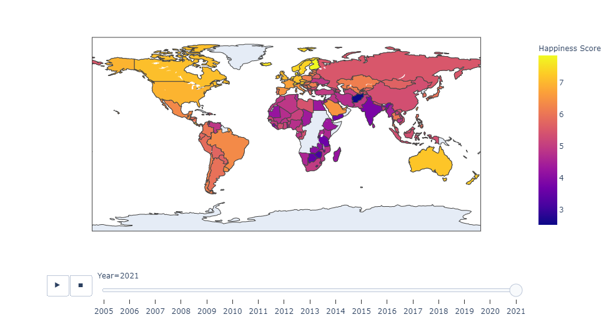
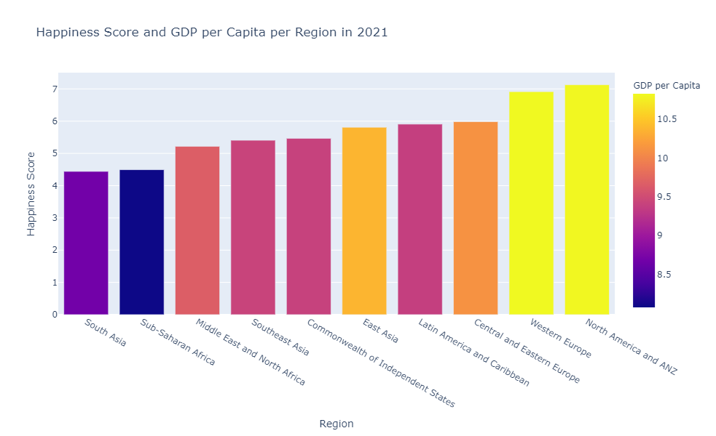
4. Data Analysis
Happiness countries/region
Western countries tend to have higher happiness scores (especially Scandinavian)
Lowest happiness scores in South Asian/African/Middle Eastern countries
Strong relation between happiness and richness

Slide 7
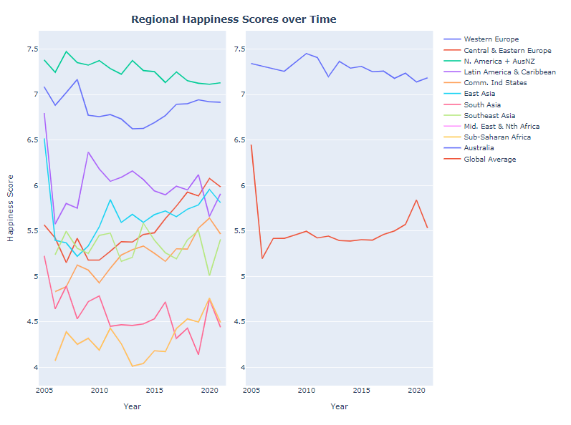
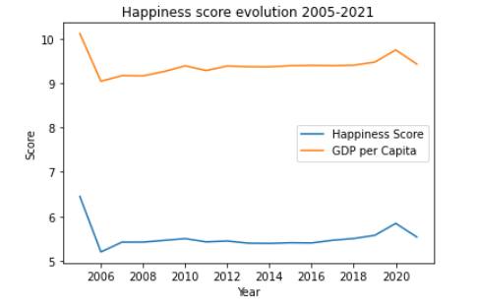
4. Data Analysis
Happiness across time
More developed regions have maintained high and relatively stable happiness levels
In less developed regions, happiness has been more volatile
Once again, strong relation between happiness and GDP per Capita (same shape)

Slide 8
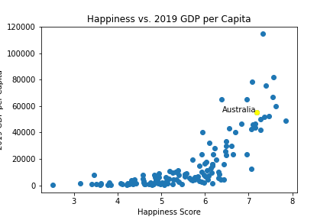
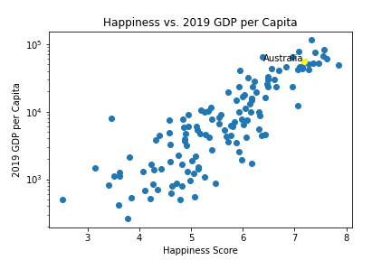
4. Data Analysis
Does money make you happy?
There is a positive relationship between the Happiness Score and GDP per Capita. As a nation's wealth increases the happiness of its citizen increases.
However, higher levels of GDP per capita provide diminishing returns on a nations Happiness Score.

Slide 9
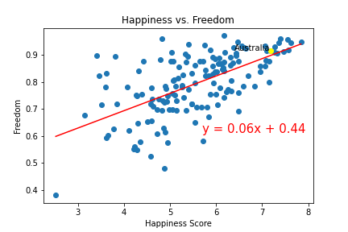
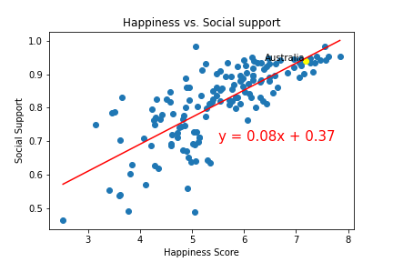
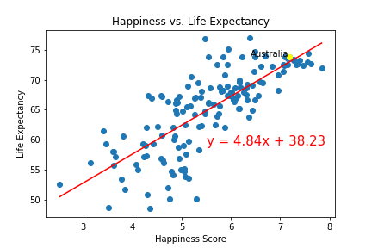
4. Data Analysis
Happiness and Social Factors
Freedom (R=0.61), Social support (R=0.76) and life expectancy (R=0.79) were all found to be strongly positively correlated with happiness score.
Level of corruption (R=-0.42) was moderately negatively correlated
‘Generosity’ showed no correlation

Slide 10
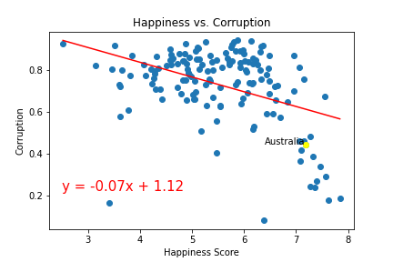
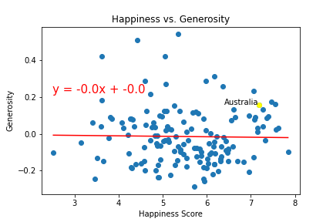
4. Data Analysis
Happiness and Social Factors
The level of perceived corruption (R=-0.42) of a nation by its citizens was found to be moderately negatively correlated against the Happiness Score.
Generosity (R=-0.02) showed no meaningful correlation with the Happiness Score.

Slide 11
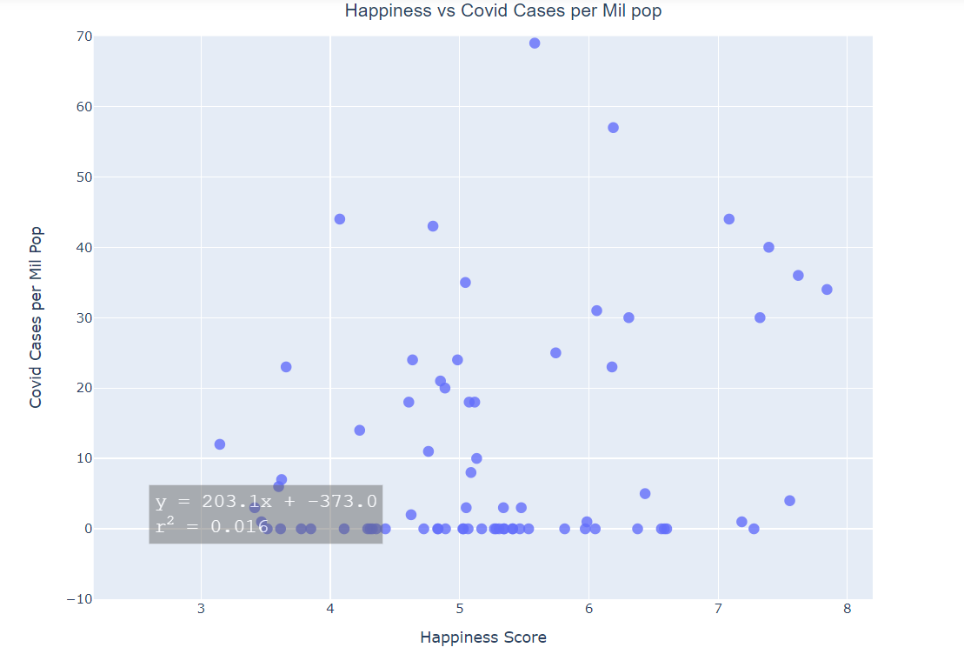
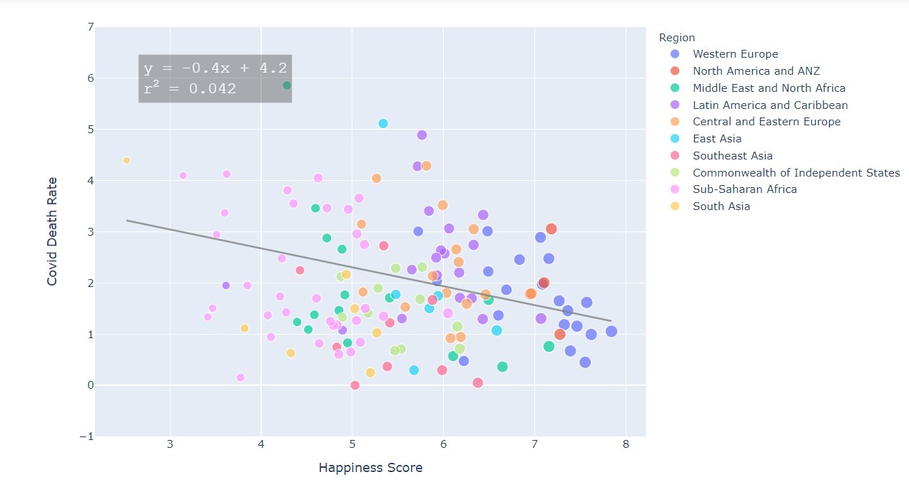
4. Data Analysis
How has COVID-19 affected happiness?
No relevant relation between happiness score and number of covid cases per mil
Negative correlation between covid death rate and happiness score (richest countries have lower death rates)
Analysis limited due to data limitations and other factors (tourism, geography etc)

Slide 12
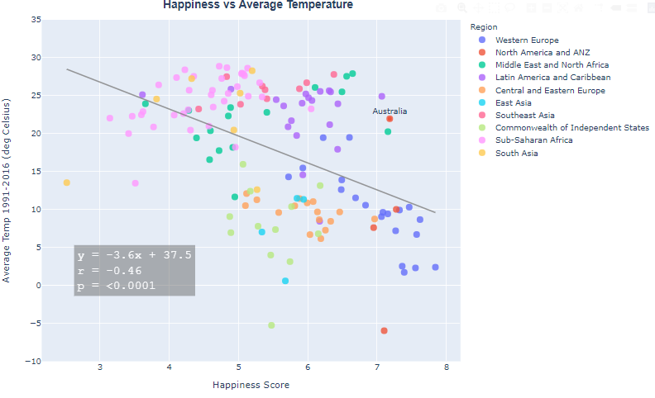
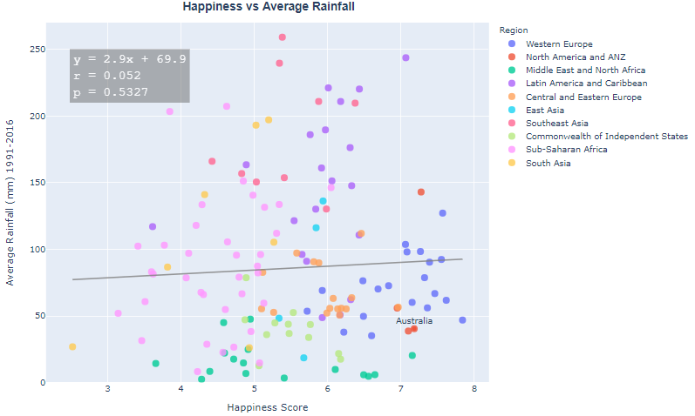
4. Data Analysis
Does better weather make you happy?
A Country’s happiness score is inversely correlated with average yearly temperature (Pearson r = -0.46).
However. Observing the regional distributions in the data, it can be seen that this relationship may be due to the fact that the wealthier nations (Western Europe, North America) all have colder climates, and poorer, nations (Africa, SE Asia) have warmer climates

Slide 13
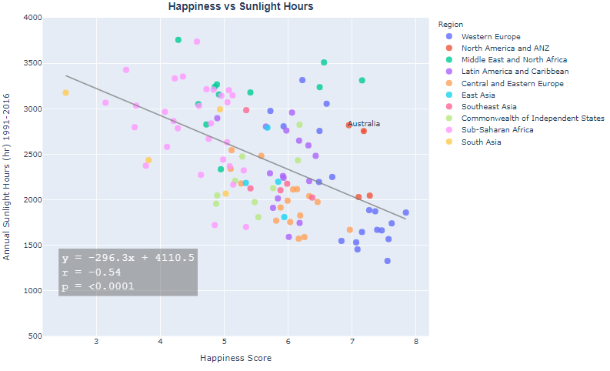
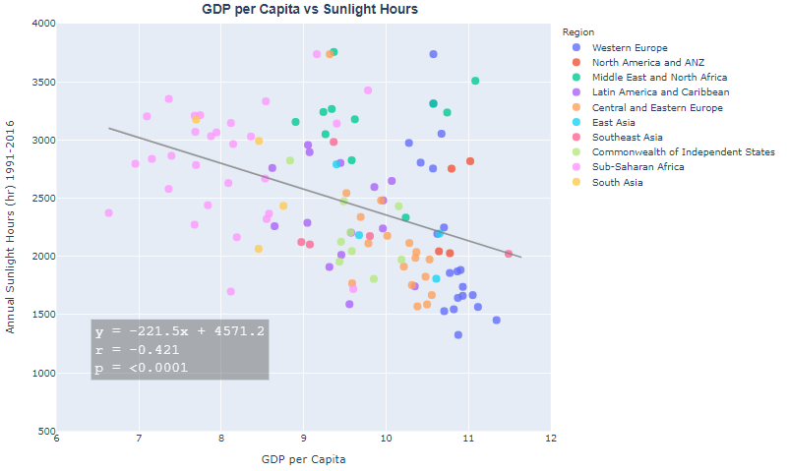
4. Data Analysis
Does better weather make you happy?
Annual sunlight hours had a similar inverse correlation to temperature.
The correlations seen are due to confounding factors, most likely GDP, that differ vastly between regions.This is evidenced by the plot on the right, of GDP vs Sunlight hours, which shows a similar distribution to the happiness vs sunlight hours plot

Slide 14
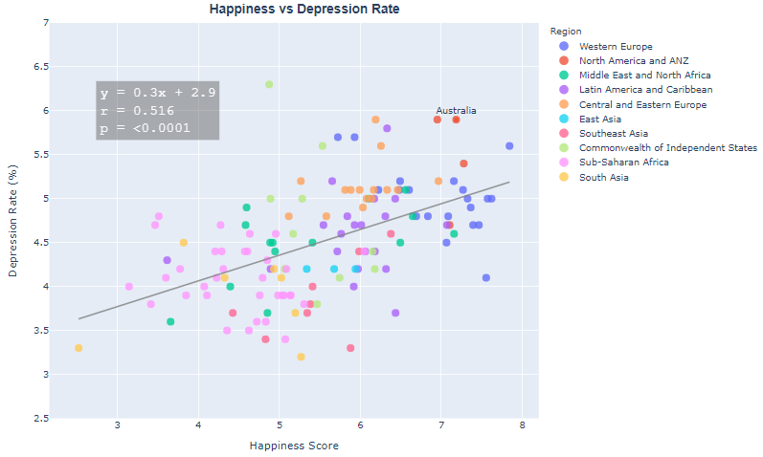
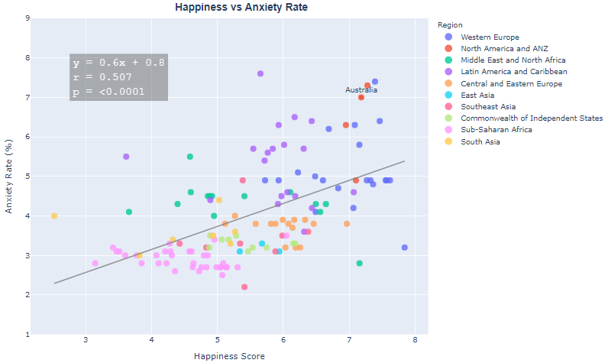
4. Data Analysis
National Happiness and levels of depression and anxiety
Both depression and anxiety are more common in ‘Happier’ nations
This may be due to better recognition, reporting and diagnosis in developed countries
Mental health is dependent on a complex balance of biopsychosocial factors, therefore disorders such as depression and anxiety still have a high prevalence despite high national happiness scores

Slide 15
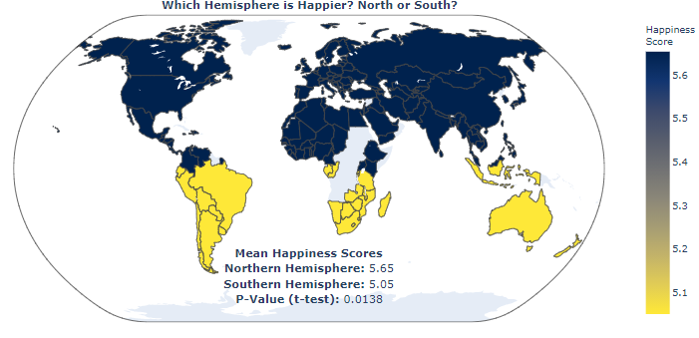
4. Data Analysis
Hypothesis testing: which hemisphere is happier?
Histogram of Happiness scores shows that happiness is approximately normally distributed across the globe, so a t-test is appropriate to assess the hypothesis
Result shows The Northern hemisphere is happier, and this is statistically significant (P=0.0138)

Slide 16
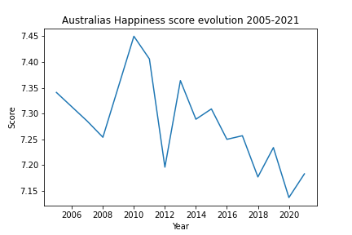
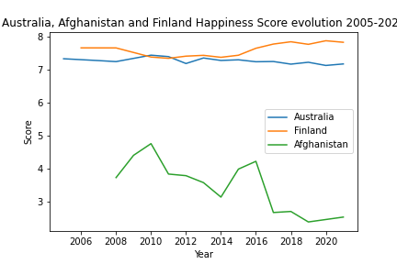
4. Data Analysis
How happy is Australia?
With a Happiness Score of 7.18, Australia is ranked the 11th happiest country in the world.
However, after peaking at a score of 7.450 in 2010, Australia’s Happiness Score has shown a trend of slow decline. At 7.84, Finland had the highest score for 2021, and Afghanistan has the lowest with 2.52.

Slide 17
5. Discussion
The happiness score is a novel concept allowing comparison of happiness on a global scale. We investigated factors that are commonly associated with health and happiness to see how closely they were associated with a nations 2021 happiness score
GDP per capita is a major contributor to a nation's happiness score. It seems money can buy you happiness, to some degree…
Social freedom’s are still important however
GDP and Resources of a country are likely confounders for many of the outcomes we looked at in our analysis
There seems to be a small trend downwards in overall happiness scores over time

Slide 18
6. Post Mortem
Happiness data set was generally clean and easy to work with
Difficulties
Large number of data sources requiring merging
A lot of questions asked, needing to be synthesised into a single report

Slide 19
7. Questions
Thankyou
Open-floor Q&A

